Slide 1
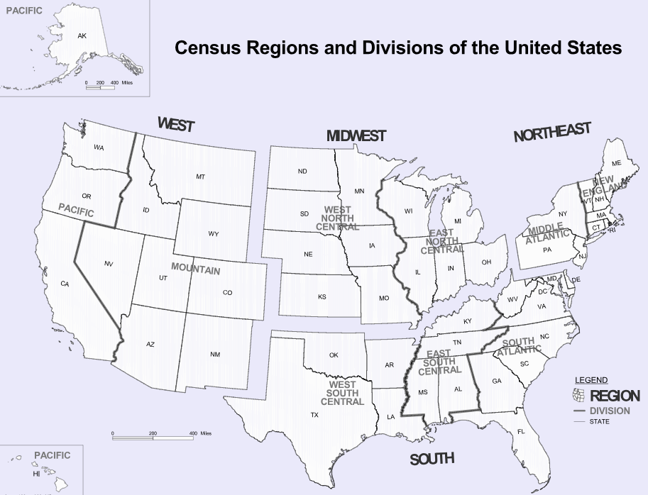


Data Processing
10 variables + Region
Diabetes Est. Percent (Diag_Pct) - Y variable
Unemployment Rate (Unemp_Rate)
Household Median Income (Income)
Percent of adults with less than a high school diploma (lt_HighSchool)
Percent of adults with a high school diploma only (only_HighSchool)
Percent of adults completing some college or associate's degree (Col_Degree)
Percent of adults with a bachelor's degree or higher (Bach_Degree)
Obesity Prev Percent (Obesity)
Leisure Time Physical Inactivity Prev Perc (Ph_Inactivity)
Median Age (Age)
Region
Notes:
There are 53 states, and I didn’t wanna miss a valuable predictor.

Slide 2
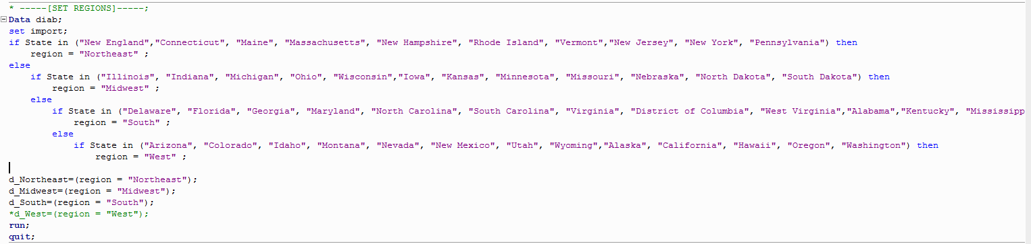
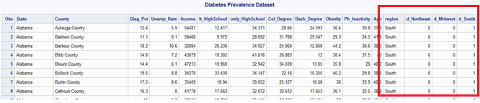

Data Processing contd..
Add dummy variables for Regions (d_Northeast, d_Midwest, d_South)
Notes:
Included the region values programmatically. The dummy variables are created based on that.

Slide 3
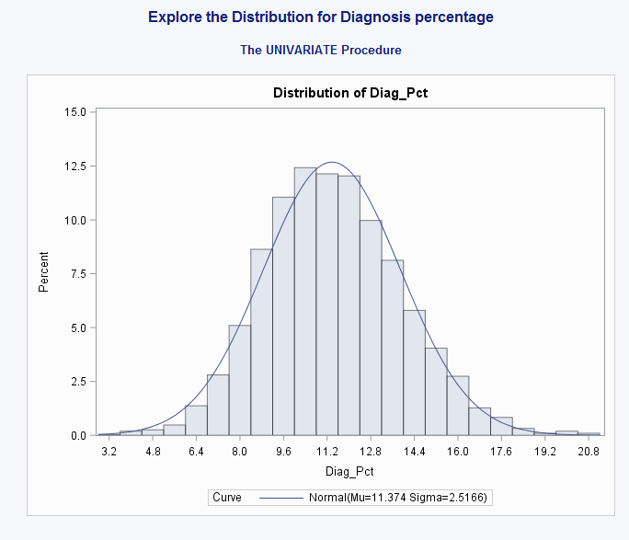
Analysis & Results
Distribution of Diag_Pct – Normal & Symmetric
Notes:
Distribution looks normal and symmetric. No transformation needed.

Slide 4
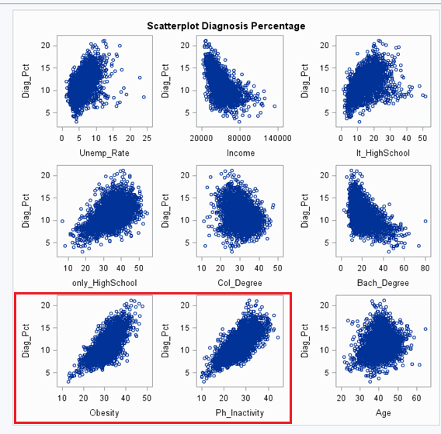
Analysis & Results
Correlation between X and Y variables
Strength\Polarity | Positive | Negative
Weak | Age | Col_Degree, d_Northeast, d_Midwest
Moderate | Unemp_Rate,lt_HighSchool, only_HighSchool, Bach_Degree, d_South | Income
Strong | Obesity, Ph_Inactivity | None
Notes:
I see a strong positive relation with Obesity and Ph_Inactivity here. Let’s see how they can help with prediction.

Slide 5
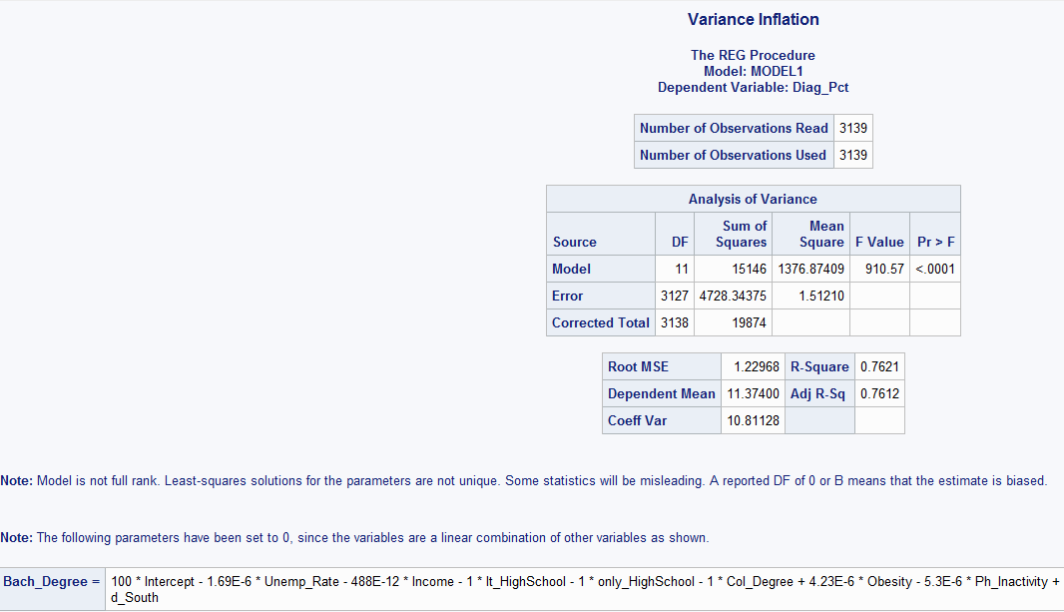
Analysis & Results
Multicollinearity
Bach_Degree is gone!
Notes:
While I attempted to check multicollinearity SAS reports that Bach_Degree is a linear combination of other variables. Hence removed it.

Slide 6
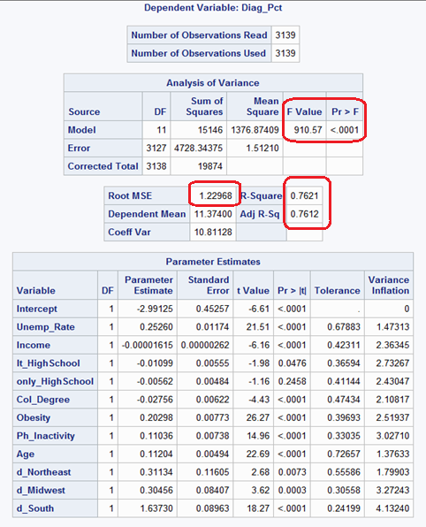

Analysis & Results
Model fitting with all variables
Notes:
No sign of multicollinearity either.
So no with 11 variables the current model looks like this. It already looks like a somewhat a good fit, but let’s remove the outliers and check it out.

Slide 7
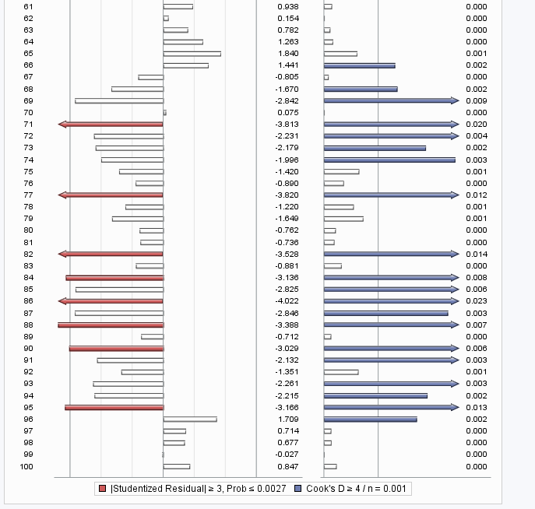
Analysis & Results
Removing outliers
3139 -> 2982 observations(157 removed)
Notes:
Removed 157 variables based on their DFFITS value.

Slide 8
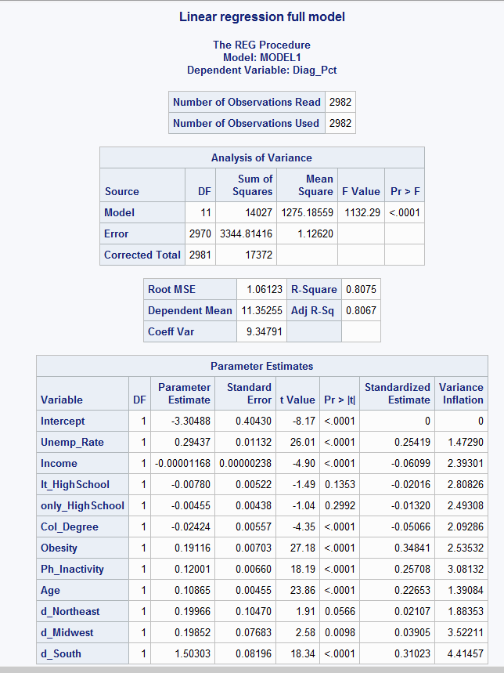
Analysis & Results
After removing outliers
Notes:
Better on the F value and Adj R-Sq. RMSE is less as well. Also the highschool related variables aren’t significant, let’s see if they go away in training phase.

Slide 9
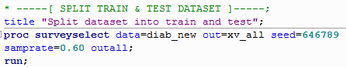
Analysis & Results
Train and Test Data
Train 60% : Test 40%
Notes:
Split the data into 60 :40 for training and testing using surveyselect.
And ran model selection methods

Slide 10
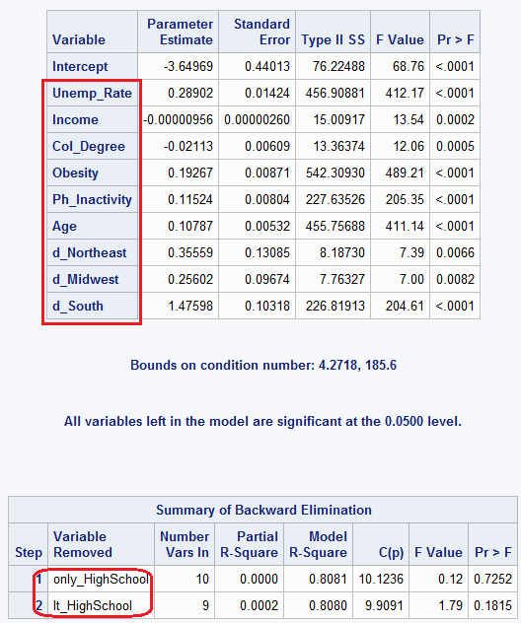

Analysis & Results
Linear Model Estimation : Test
Selection Method : Backward Elimination (M1)
9 X-Variables
Notes:
On backware elimination method, it removed the high schoold degree only, and less that highscool variables. Now left with 9 variables.

Slide 11
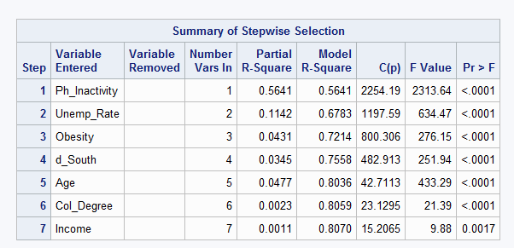
Analysis & Results
Selection Method : Stepwise Selection(M2)
7 X-Variables
Notes:
On stepwise it removed 4 variables including the d_Midwest and d_West dummy variables. Now we have 7 significant variables left.

Slide 12
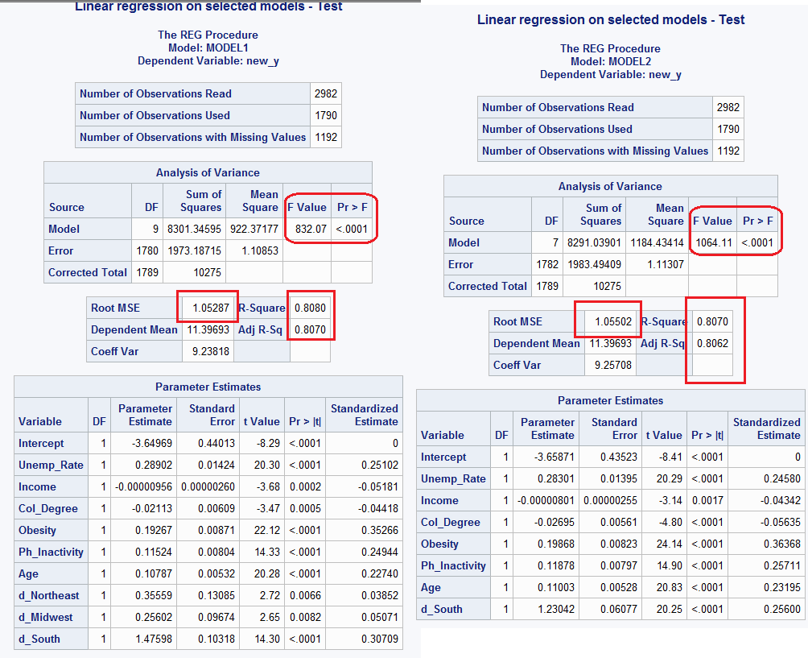
Analysis & Results
M1 & M2 summary
Notes:
Here are the final two models I have from the two different selection methods. 2nd has a better F value, the rest are almost similar.

Slide 13
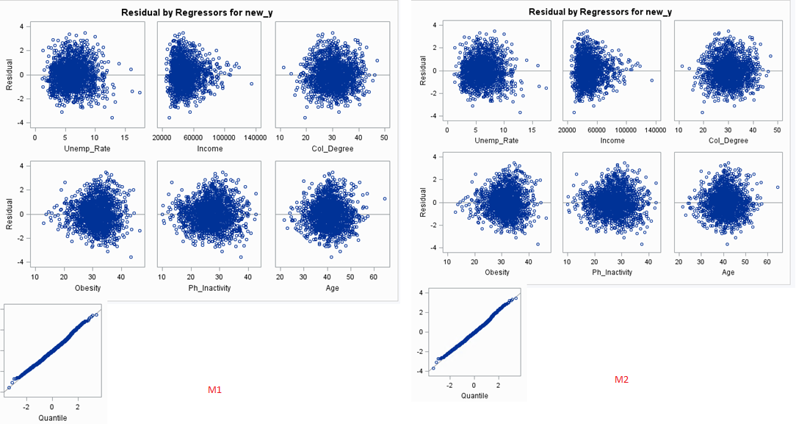
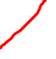
Analysis & Results
M1 & M2 Residuals
Notes:
Residuals are okay, except income but it’s not so alarming.
Let’s check how they perform on test dataset.

Slide 14
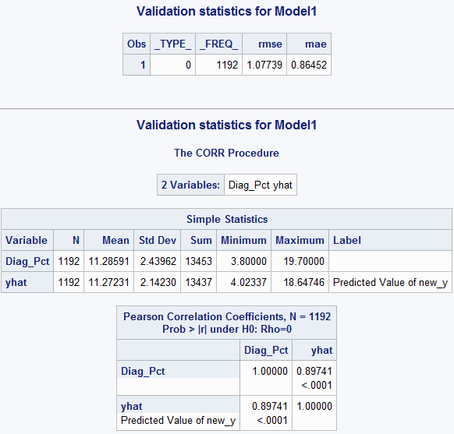
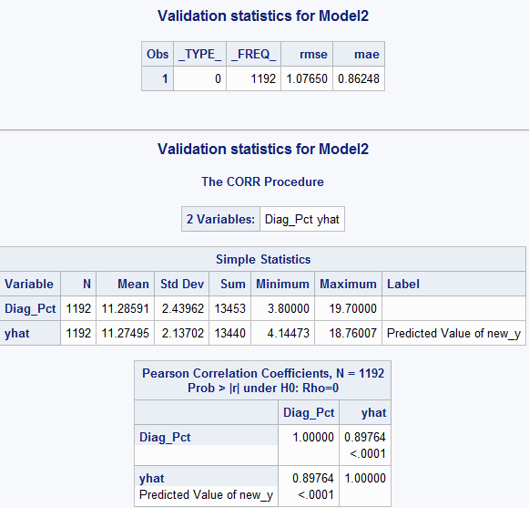
Analysis & Results
Test Data Validation (M1 & M2)
Train |  | Model 1 | Model 2
 | RMSE | 1.05 | 1.05
 | R-Square | 0.808 | 0.807
 | Adj-R-Square | 0.807 | 0.806
 | GOF | (OK)F=832/<0.0001 | (OK)F=1064/<0.0001
 | Residuals | OK | OK
Test
 | RMSE | 1.07739 | 1.0765
 | MAE | 0.8645 | 0.8624
 | R-Square | 0.805344708 | 0.80575757
 | Adj-R-Square | 0.80385782 | 0.80460156
 | CV-R-Square | 0.002655292 | 0.00124243
Notes:
On the test data, computed the new_y variables and found their difference from the observed. This is how they performed. Calculated the cross validated r square.
M2 has better Adj-Rsq, CV-Rsq.

Slide 15

Conclusion
Model Equation
Diag_Pct = -3.66 + 0.28 Unemp_Rate - 0.00001 Income – 0.027 Col_Degree + 0.20 Obseity + 0.12 Ph_Inactivity + 0.11 Age +1.23 d_South
The significance of the predictors goes in this order
Obesity > Ph_Inactivity > d_South > Unemp_Rate > Age > Col_Degree > Income
Notes:
In comparison model 2 seems to perform slightly better, hence the I chose that model as my result. Here is it’s full equation.

